Slide 1



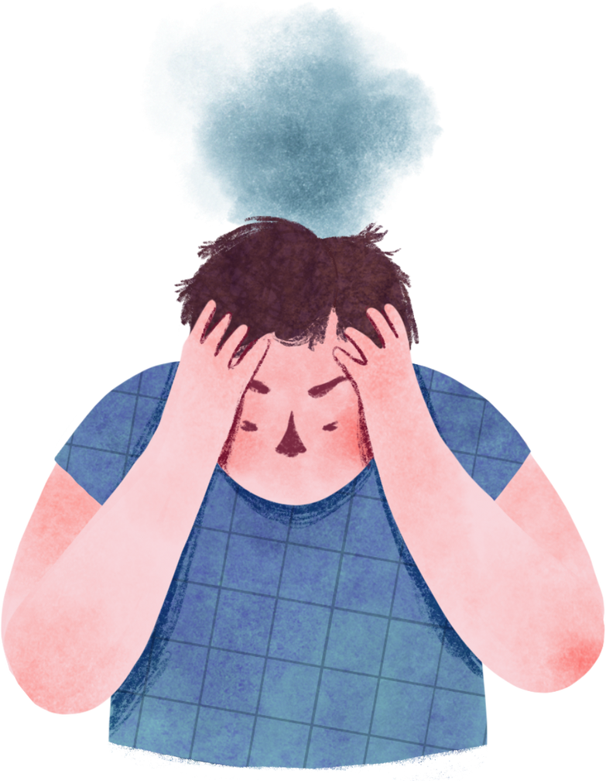
Impact of Mental Health and Lifestyle Factors on Academic Performance
By: Ganna Ehab

Slide 2


LET ME TAKE YOU ON A JOURNEY ABOUT HOW THIS PROJECT STARTED

Slide 3

01 - INTRODUCTION
PeT
WHY I CHOSE THIS TOPIC?

Slide 4
01 - INTRODUCTION
Data collection
Method: Google Forms posted on
HTI Official Pages and groups on social media and website.

Slide 5
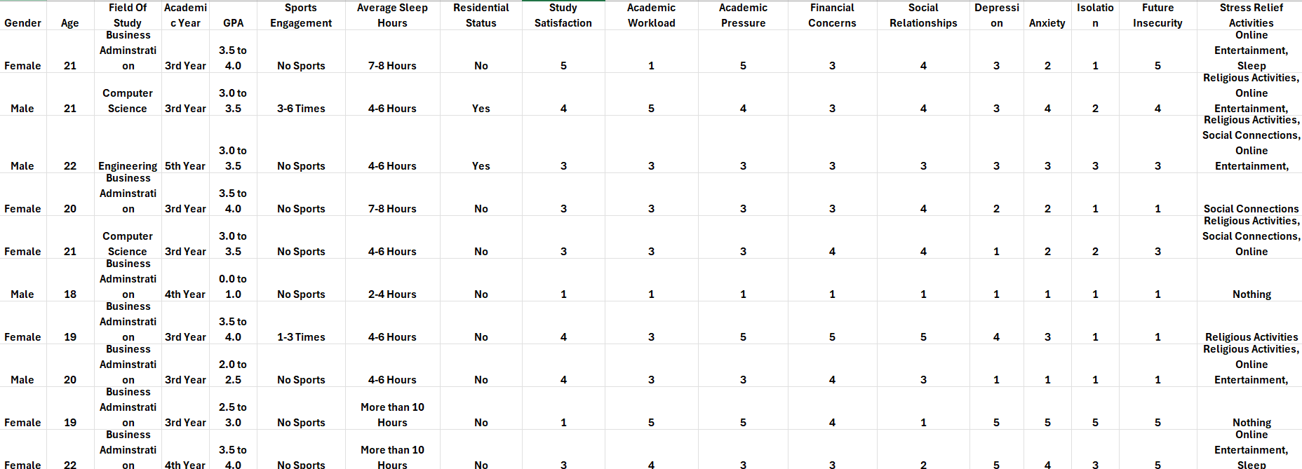
01 - INTRODUCTION
Dataset
PeT

Slide 6
01 - INTRODUCTION
Dataset
PeT
Sample Size: 325 students.
Demographics: Gender, Age, Field of Study, Academic Year, and GPA.
Lifestyle Factors: Sports Engagement, Sleep Hours, Residential Status.
Mental Health Metrics: Study Satisfaction, Academic Workload, Academic Pressure, Financial Concerns, Anxiety, Depression, and Isolation.
Stress Relief Activities: Includes Religious Activities, Online Entertainment, Sleep, Social Connections, etc...

Slide 7
01 - INTRODUCTION
Data Cleaning Stage
PeT

Slide 8
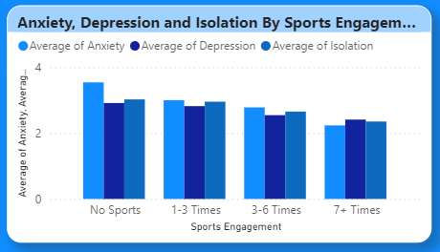

01 - INTRODUCTION
Questions And Answers
1- Does Sports Engagement have an effect on Anxiety,Depression and isolation levels?
PeT

Slide 9
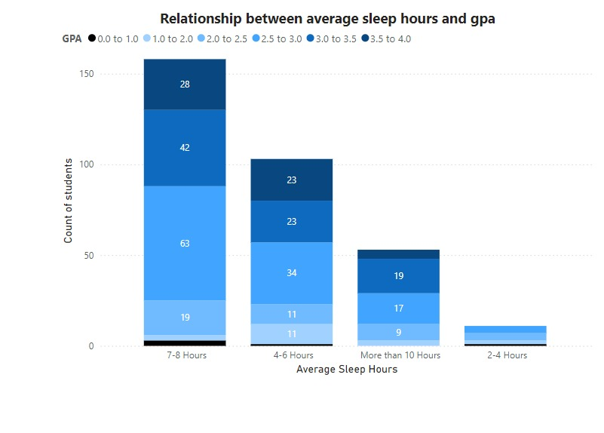

01 - INTRODUCTION
Questions And Answers
PeT
2-What’s the Relationship between average sleep hours and GPA?

Slide 10
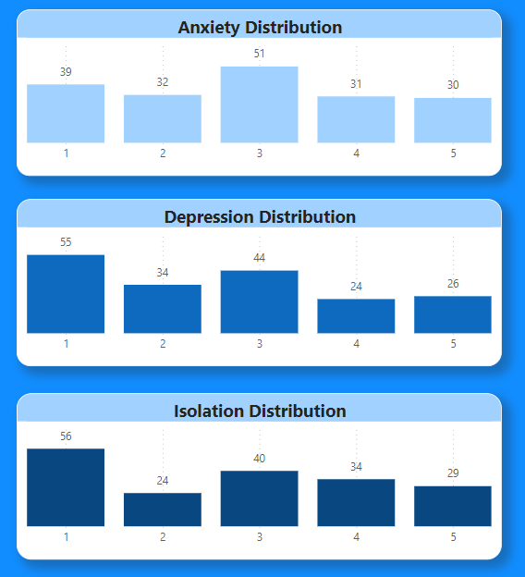
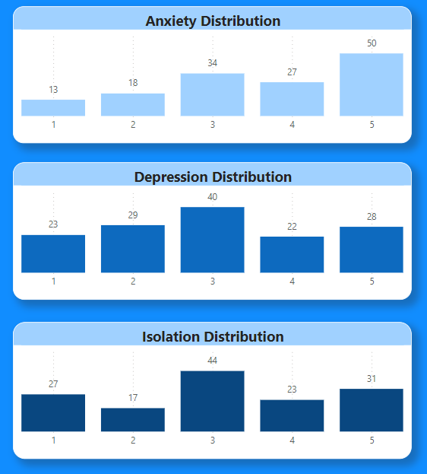
01 - INTRODUCTION
Questions And Answers
3-Does it Differ from Females to Males in Mental health levels?
PeT
MALES
FEMALES

Slide 11
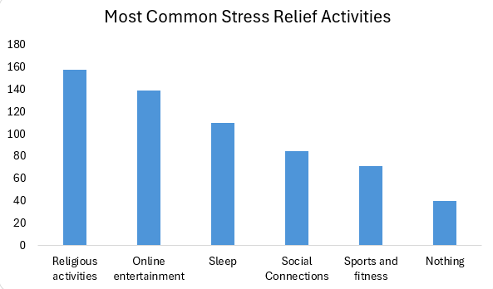

01 - INTRODUCTION
Questions And Answers
PeT
4-What Are the Most common stress relief activities?

Slide 12
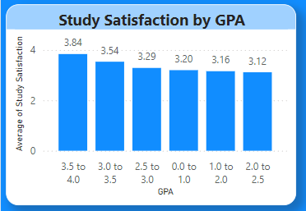
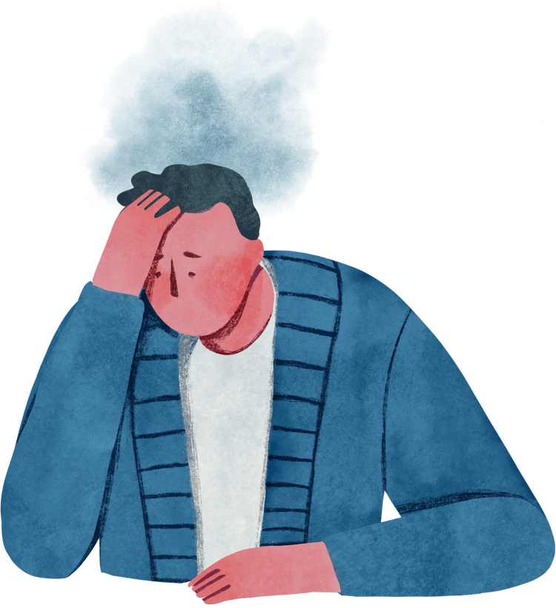
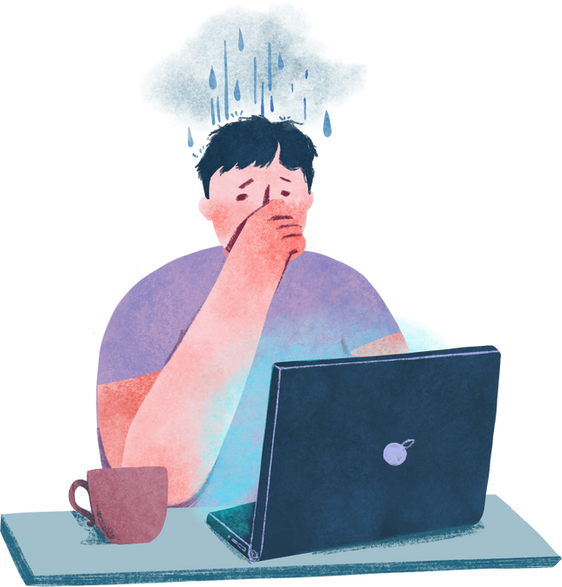
01 - INTRODUCTION
Questions And Answers
PeT
5- Does GPA have an influence on study satisfaction?

Slide 13

01 - INTRODUCTION
NOW LET’S VIEW OUR DASHBOARD ON POWER BI!

Slide 14
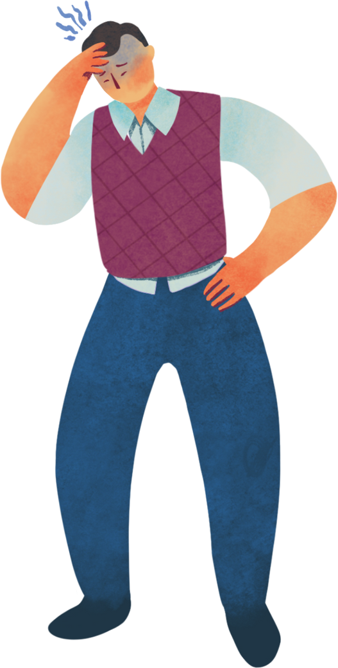
03 - DOCUMENTATION
Actionable Recommendations for Improving Student Mental Health and Academic Performance

Slide 15
03 - DOCUMENTATION
Actionable Recommendations for Improving Student Mental Health and Academic Performance
The college could consider adding gym facilities to promote physical activity, which has been shown to reduce anxiety, depression, and isolation among students.

Slide 16
03 - DOCUMENTATION
Actionable Recommendations for Improving Student Mental Health and Academic Performance
Create a student activity that emphasizes social connections by allowing students to join study groups with unfamiliar peers who are studying the same subject.

Slide 17
03 - DOCUMENTATION
Actionable Recommendations for Improving Student Mental Health and Academic Performance
Create entertaining educational videos for various subjects and share them on social media platforms, blending learning with online entertainment. This approach would make studying more engaging and align with students' preferences for consuming content online.

Slide 18
03 - DOCUMENTATION
Actionable Recommendations for Improving Student Mental Health and Academic Performance
The college could collaborate with mental health professionals to provide tailored support and resources for students, helping to address mental health challenges such as anxiety, depression, and isolation. This partnership would create a healthier, more supportive environment for students to thrive academically and personally

Slide 19
Presentation
Any Questions?
Sandra Haro

Slide 20
Thank you
Sandra Haro

